Slide 1
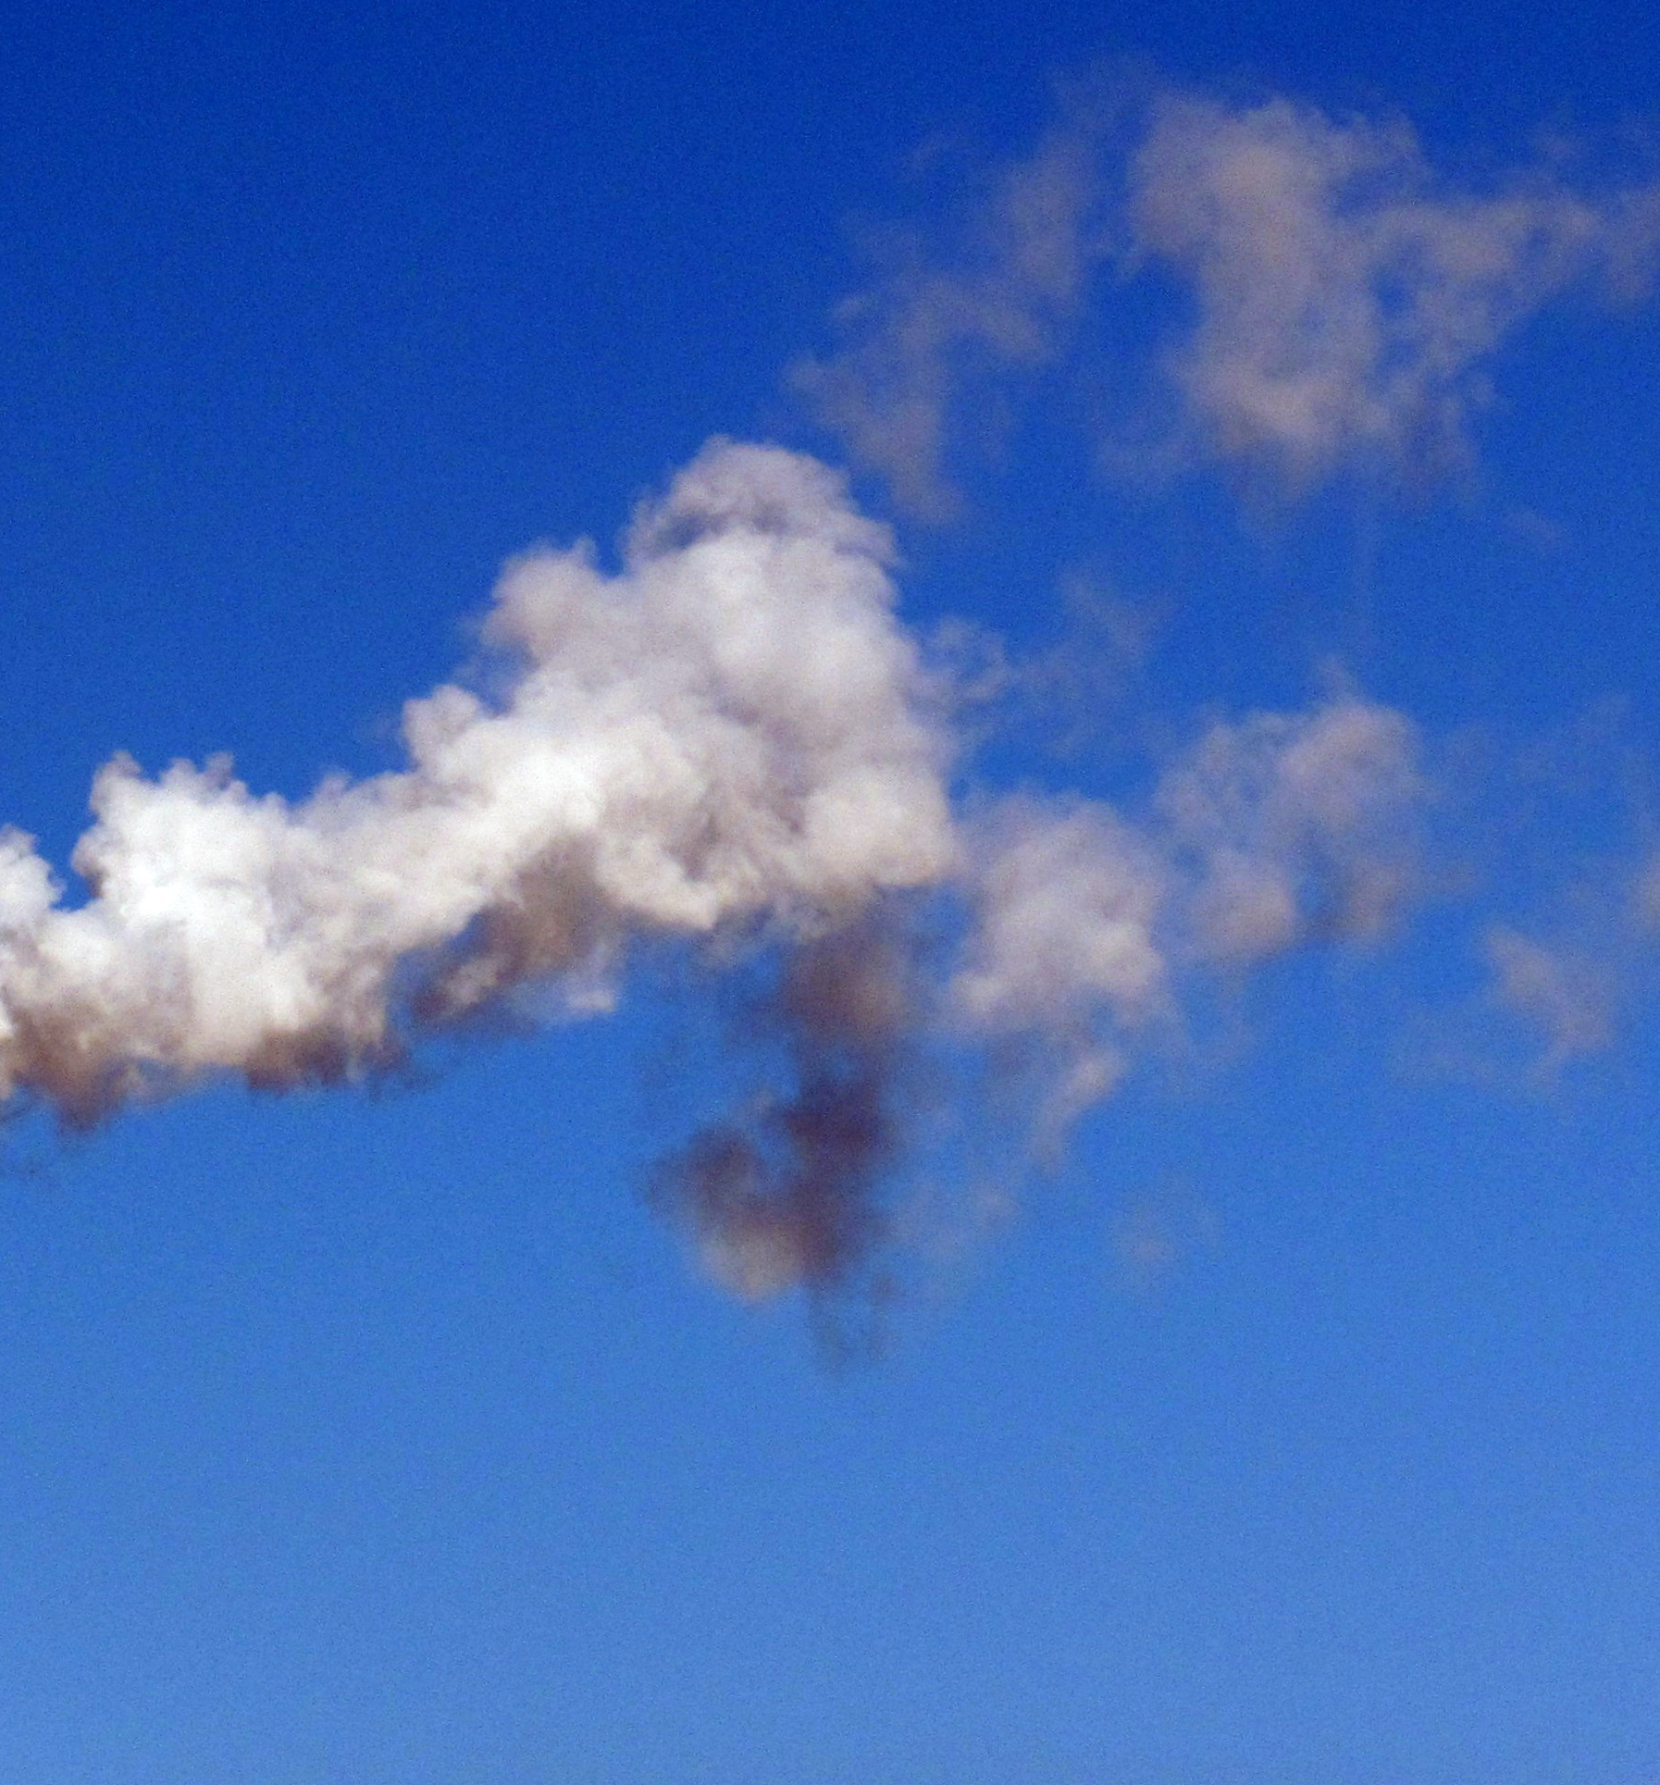
Prediction Model Presentation
Moyosore Akintola
Chioma Ulom
Gift Ajayi
Oluwaseun Ademokun

Slide 2

Project Goal
Based on NPRI data, which industry is predicted to have the highest growth of releases in 2023? Which will have the largest decline?

Slide 3

Data Merging
The project merges the NPRI dataset with a Greenhouse Gas Emissions (GHGEmissionsGES) dataset.

Slide 4
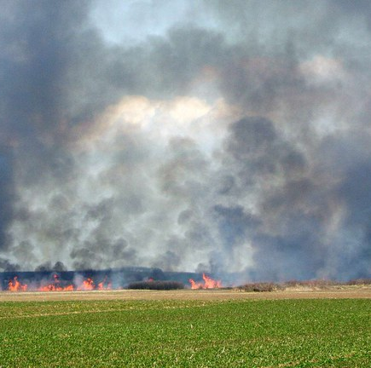
Feature Engineering
Creating 'total_releases' Feature:
A list of columns representing different types of pollutant releases and emissions
A new column named 'total_releases' is created
The individual columns used to create total_releases are dropped

Slide 5
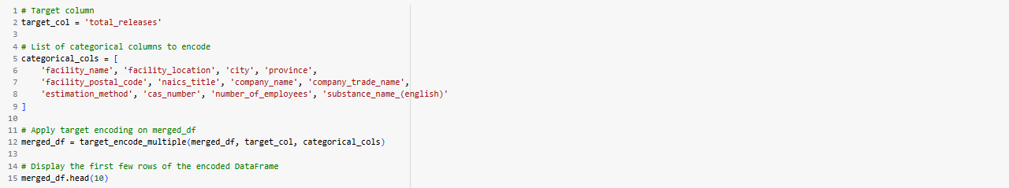

Feature Encoding
Target Encoding
One-Hot Encoding

Slide 6
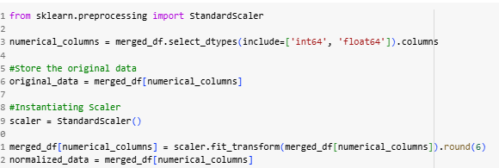
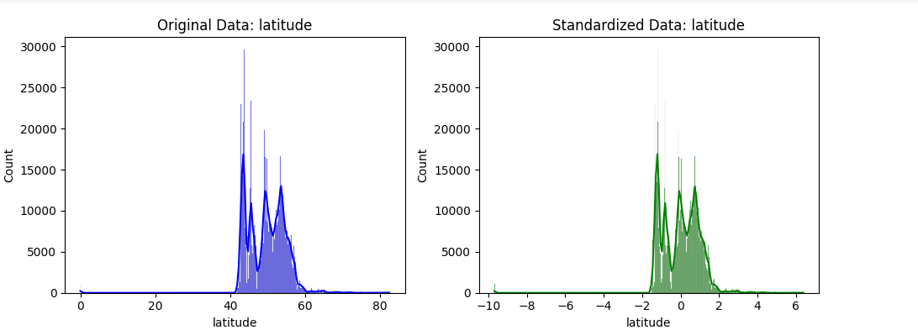
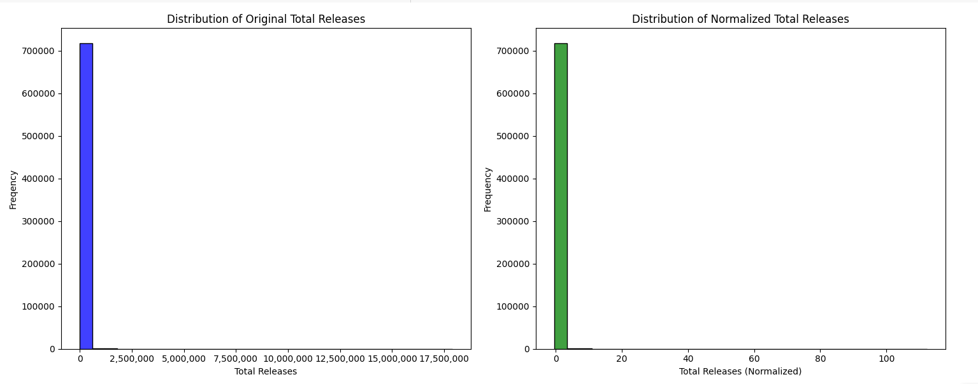
Normalization
StandardScaler() was used on the dataset

Slide 7
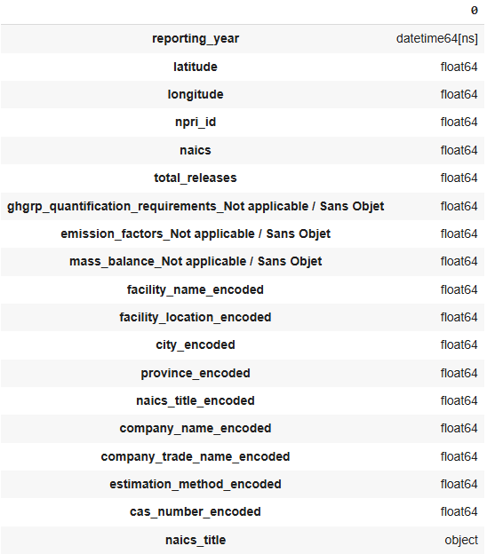
FEATURE SELECTION
Correlation carried out for all the features
Selected columns with correlation coefficient >= 0.9
Features selected using P-values with significance level of 0.05

Slide 8
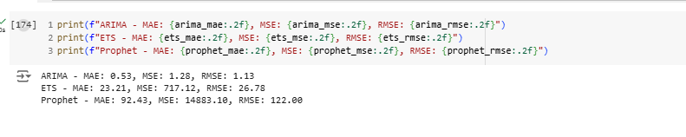
Model Evaluation
Evaluated Three(3) models:
ARIMA
Exponential Smoothing
Prophet
Metric used:
Mean Absolute Error(MAE)
Mean Square Error (MSE)
Root Squared Mean Square Error (RMSE)
Best performing model was ARIMA with the lowest MAE, MSE and RMSE

Slide 9
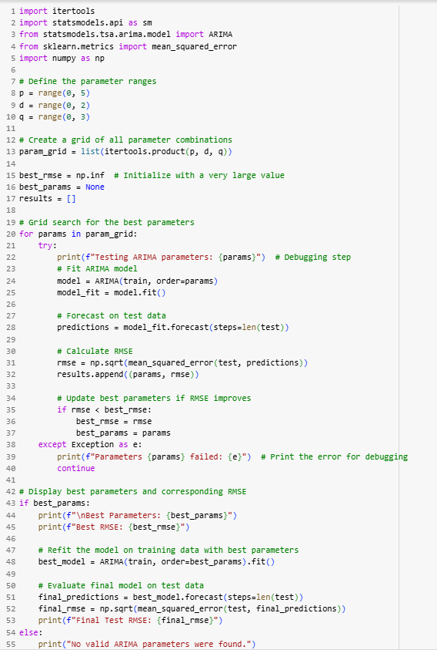
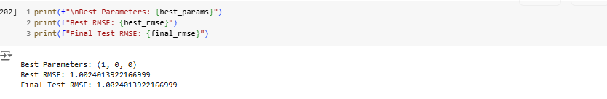
HyperParameter Tuning
Ranges were used for the parameters – p, d and q
p = range(0, 5)
d = range(0, 2)
q = range(0, 3)
Best Parameter determined using rmse.
Best parameter (p, d, q) - (1, 0, 0)

Slide 10
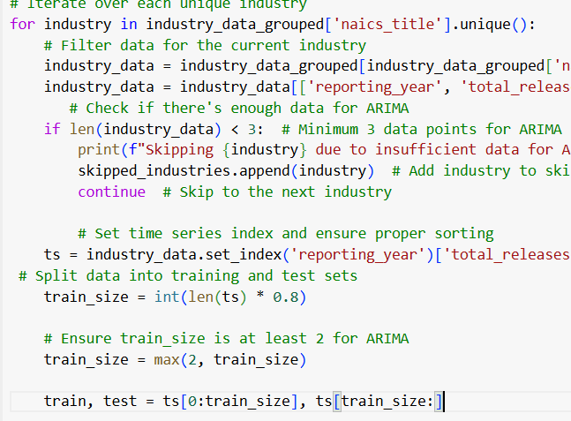
MoDel Prediction: ARIMA Forecasting
Industry Iteration:
Process each industry in the dataset individually.
Data Preparation:
Filter relevant columns: reporting_year and total_releases.
Ensure a minimum of 3 data points for modeling.
Time-Series Setup:
Set reporting_year as the index and sort chronologically.
Split data into training (80%) and testing sets.

Slide 11
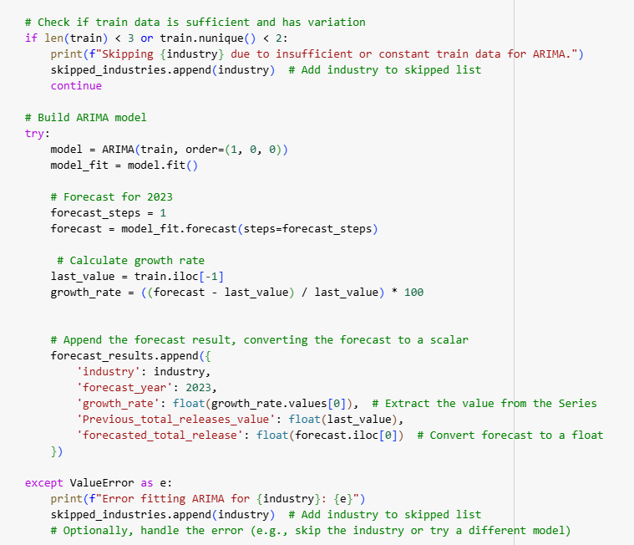
MoDel Prediction: ARIMA Forecasting ​
Model Building:
Train ARIMA model (Order: (1, 0, 0)) on the training data.
Skip industries with insufficient or constant training data.
Forecasting & Logging:
Predict one-step ahead, that is, for 2023.
Calculate growth rate
Save results (industry, forecast year, growth rate, previous value, forecasted value).
Error Handling:
Log skipped industries or errors during model fitting.

Slide 12
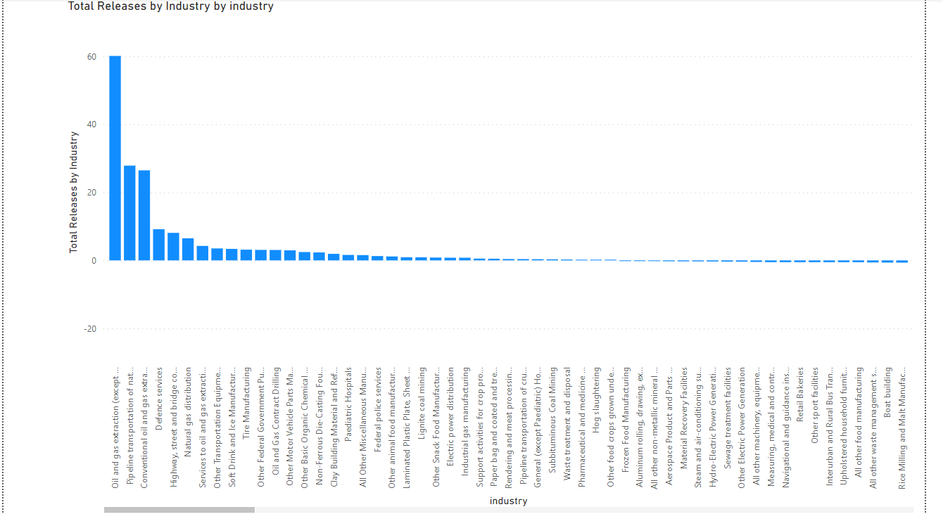

Slide 13
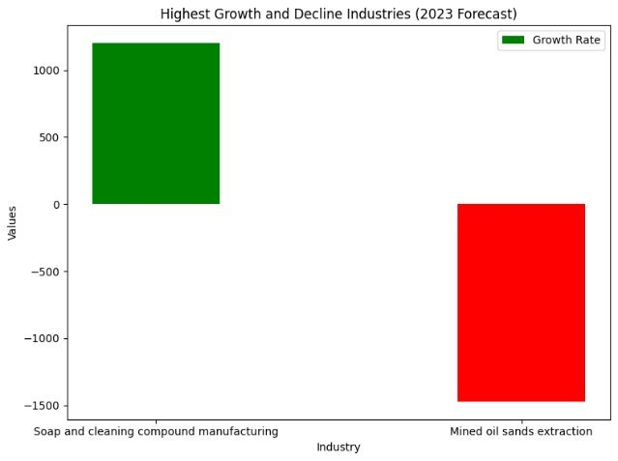
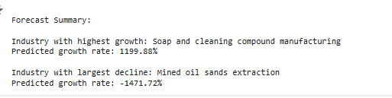

Forecasted result for 2023
Industry with Highest Release in 2023:
Oil and gas extraction(except oil sands)
Industry with Lowest Release in 2023:
Petroleum refineries
Industry with Highest Growth:
Soap and cleaning compound manufacturing
Industry with Largest Decline:
Mined oil sands extraction

Slide 14
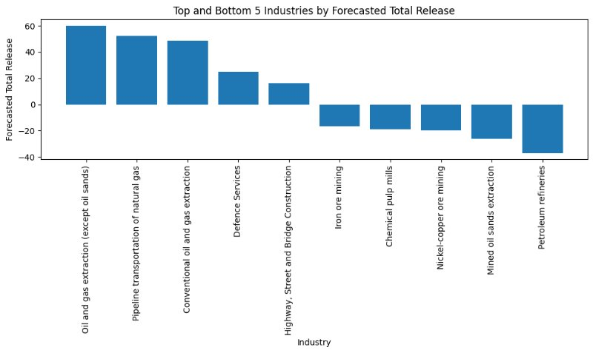
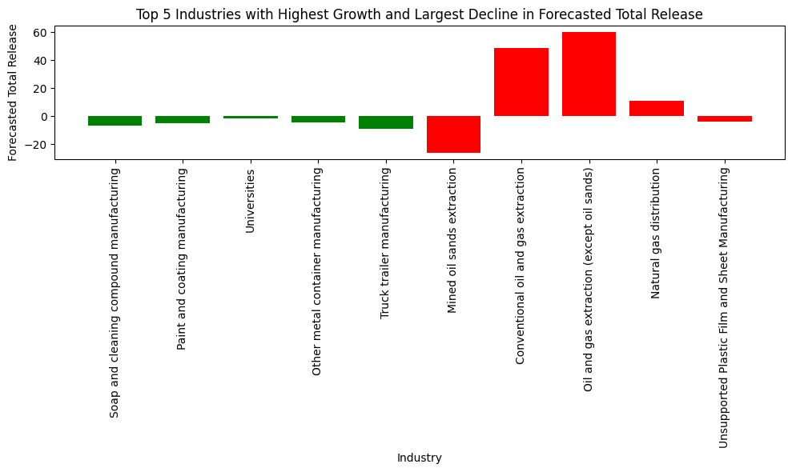
Forecast 2023 results

Slide 15
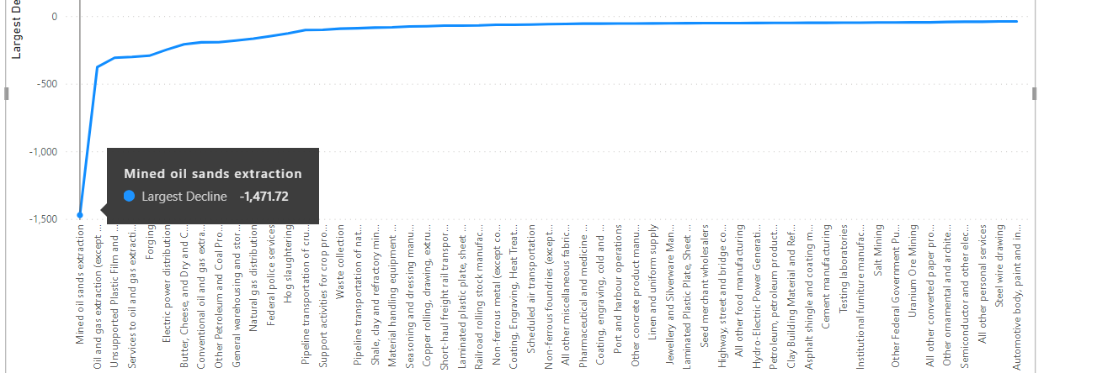

Slide 16
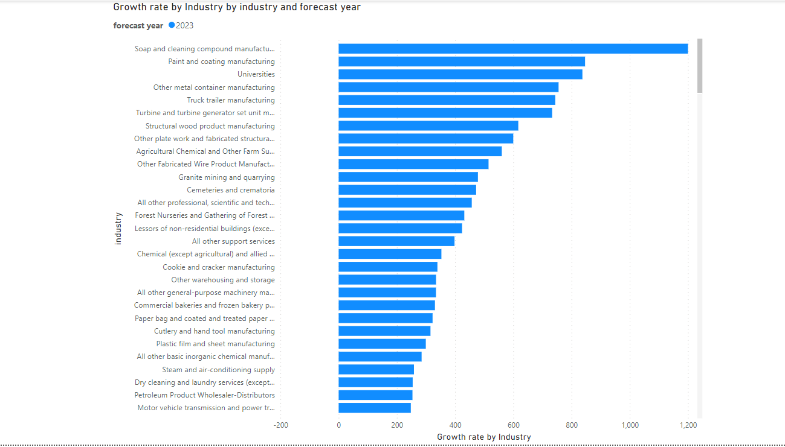

Slide 17


